Slide 1
Linux Time
Azhe Liu
2012.1.4

Slide 2
Outline
The Tick Rate: HZ
Jiffies
Hardware Clocks and Timers
The Timer Interrupt Handler
The Time of Day
Timers
Delaying Execution
High-Resolution Timers

Slide 3
Effect of Timer interrupt
1. Updating the system uptime
2. Updating the time of day
3. On an SMP system, ensuring that the scheduler runqueues are balanced.
4. Running any dynamic timers that have expired
5. Updating resource usage and processor time statistics

Slide 4
Hardware dependent
1. Clock cycle
PIT(programmable interrupt timer)
arch/arm/mach-mmp/include/mach/timex.h -- Marvell pxa920
#define CLOCK_TICK_RATE 3250000
arch/arm/mach-msm/include/mach/timex.h -- MSM 7227
#define CLOCK_TICK_RATE 1000000
2. Clock tick
PIT counter decrease to 0, then generate a timer interrupt.
3. HZ
Number of interrupts per second.
4. Interval of clock tick (not exit now.)
kernel/timer.c
long tick = (1000000 + HZ/2) / HZ; /* timer interrupt period */
5. LATCH
Need to be write in to PIT.
include/linux/jiffies.h
#define LATCH ((CLOCK_TICK_RATE + HZ/2) / HZ)

Slide 5
HZ
Define HZ
arch/arm/include/asm/param.h
# define HZ CONFIG_HZ
include/generated/autoconf.h
#define CONFIG_HZ 100 -- PICO project(8x55)
#define CONFIG_HZ 128 -- Marvell project(PXA920)
Hardware dependent
Programmable interrupt timer (PIT).system timer interrupt (interrupt zero) at HZ frequency.

Slide 6
The Ideal HZ Value
1. Advantages with a Larger HZ
1). Kernel timers increased accuracy.
2). Poll()and select() execute with improved precision.
3). Measurements, such as resource usage or the system uptime, are recorded with a
f iner resolution.
4). Process preemption occurs more accurately.
2. Disadvantages with a Larger HZ
More frequent timer interrupts.less processor time available for other work.

Slide 7
jiffies
The global variable jiffies holds the number of ticks that have occurred since the system booted.
Useage:
<linux/jiffies.h>
extern unsigned long volatile jiffies;
unsigned long time_stamp = jiffies; /* now */
unsigned long next_tick = jiffies + 1; /* one tick from now */
unsigned long later = jiffies + 5*HZ; /* five seconds from now */
unsigned long fraction = jiffies + HZ / 10; /* a tenth of a second from now */

Slide 8
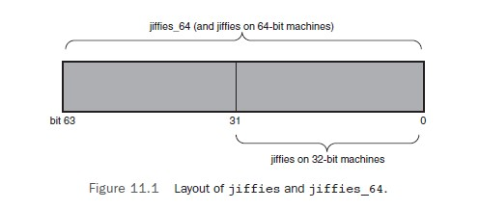
jiffies_64
1. jiffies
HZ = 100 497 days overflow
HZ = 1000 49.7 days overflow
2. jiffies_64
extern unsigned long volatile jiffies;
extern u64 jiffies_64;
arch/arm/kernel/vmlinux.lds.S
jiffies = jiffies_64;
3. get_jiffies_64();

Slide 9
jiffies usage
#include <linux/jiffies.h>
int time_after(unsigned long a, unsigned long b);
int time_before(unsigned long a, unsigned long b);
int time_after_eq(unsigned long a, unsigned long b);
int time_before_eq(unsigned long a, unsigned long b);
diff = (long)t2 - (long)t1;.
You can convert a jiffies difference to milliseconds trivially through:
msec = diff * 1000 / HZ;
jiffies to timerspec
#include <linux/time.h>
unsigned long timespec_to_jiffies(struct timespec *value);
void jiffies_to_timespec(unsigned long jiffies, struct timespec *value);
unsigned long timeval_to_jiffies(struct timeval *value);
void jiffies_to_timeval(unsigned long jiffies, struct timeval *value);

Slide 10
User-Space and HZ
1. jiffies_64_to_clock_t()
Example:
unsigned long start;
unsigned long total_time;
start = jiffies;
/* do some work ... */
total_time = jiffies - start;
printk(“That took %lu ticks\n”, jiffies_to_clock_t(total_time));
2. kernel/time.c
clock_t jiffies_to_clock_t(long x)
{
...
# if HZ < USER_HZ
return x * (USER_HZ / HZ);
# else
return x / (HZ / USER_HZ);
# endif
...
}

Slide 11
The Timer Interrupt Handler
static void tick_periodic(int cpu)
{
if (tick_do_timer_cpu == cpu) {
write_seqlock(&xtime_lock);
/* Keep track of the next tick event */
tick_next_period = ktime_add(tick_next_period, tick_period);
do_timer(1);
write_sequnlock(&xtime_lock);
}
/*update various statistics that a tick has elapsed*/
update_process_times(user_mode(get_irq_regs()));
profile_tick(CPU_PROFILING);
}
void do_timer(unsigned long ticks)
{
jiffies_64 += ticks;
update_wall_time();
/*updates the system’s load average statistics*/
calc_global_load();
}

Slide 12
The Time of Day
struct timespec {
__kernel_time_t tv_sec; /* seconds */
long tv_nsec; /* nanoseconds */
};
System call
gettimeofday()
settimeofday()
asmlinkage long sys_gettimeofday(struct timeval *tv, struct timezone *tz)
{
if (likely(tv)) {
struct timeval ktv;
do_gettimeofday(&ktv);
if (copy_to_user(tv, &ktv, sizeof(ktv)))
return -EFAULT;
....
}

Slide 13
Timers API
struct timer_list {
struct list_head entry; /* entry in linked list of timers */
unsigned long expires; /* expiration value, in jiffies */
void (*function)(unsigned long); /* the timer handler function */
unsigned long data; /* lone argument to the handler */
struct tvec_t_base_s *base; /* internal timer field, do not touch */
};
Use timer API
struct timer_list my_timer;
init_timer(&my_timer);
my_timer.expires = jiffies + delay; /* timer expires in delay ticks */
my_timer.data = 0; /* zero is passed to the timer handler */
my_timer.function = my_function; /* function to run when timer expires */
add_timer(&my_timer);
void my_timer_function(unsigned long data);
mod_timer(&my_timer, jiffies + new_delay); /* new expiration */
del_timer(&my_timer);
del_timer_sync(&my_timer); //For SMP, but maybe sleep.

Slide 14
Timer rules
The same with interrupt context (atomic).
1. No access to user space is allowed.
2. The current pointer is not meaningful in atomic mode and cannot be used.
3. No sleeping or scheduling may be performed.

Slide 15
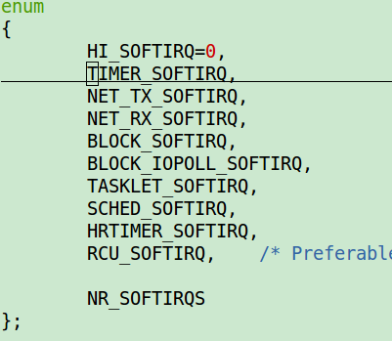
Timer list Implementation
The timer interrupt handler runs update_process_times(), which calls run_local_timers():
void run_local_timers(void)
{
hrtimer_run_queues();
raise_softirq(TIMER_SOFTIRQ); /* raise the timer softirq */
softlockup_tick();
}
runs all the expired timers (if any) on the current processor.

Slide 16
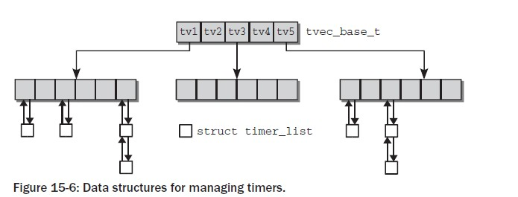
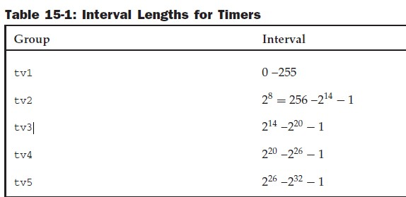
Timers index
The kernel scans this list every time there is a timer interrupt,
increments the index position by 1.
After 256 ticks, timers of the higher groups
must be pushed forward successively in order to replenish the first group.

Slide 17
Tasklets
1. They are always run at interrupt time, they always run on the same CPU that schedules them
2. a tasklet, just like a kernel timer, is executed (in atomic mode) in the context of a “soft interrupt,” a kernel mechanism that executes asynchronous tasks with hardware
interrupts enabled.
#include <linux/interrupt.h>
struct tasklet_struct {
/* ... */
void (*func)(unsigned long);
unsigned long data;
};
Scheduling Tasklets:
1) A tasklet can be disabled and re-enabled later; it won’t be executed until it is
enabled as many times as it has been disabled.
2) A tasklet can be scheduled to execute at normal priority or high priority.
3) Tasklets may be run immediately if the system is not under heavy load but never
later than the next timer tick.
4) itself—the same tasklet never runs simultaneously on more than one
processor.

Slide 18
Tasklet useage
void tasklet_init(struct tasklet_struct *t,
void (*func)(unsigned long), unsigned long data);
DECLARE_TASKLET(name, func, data);
DECLARE_TASKLET_DISABLED(name, func, data);
void tasklet_disable(struct tasklet_struct *t);
void tasklet_disable_nosync(struct tasklet_struct *t);
void tasklet_enable(struct tasklet_struct *t);
void tasklet_schedule(struct tasklet_struct *t);
void tasklet_hi_schedule(struct tasklet_struct *t);
void tasklet_kill(struct tasklet_struct *t);

Slide 19
Workqueues
1. Workqueue run in process context.
2.Tasklets run in software interrupt context with the result that all tasklet code
must be atomic.
struct workqueue_struct workqueue;
struct work_struct work;
Useage:
struct workqueue_struct *create_workqueue(const char *name);
struct workqueue_struct *create_singlethread_workqueue(const char *name);
Static init:
DECLARE_WORK(name, void (*function)(work_struct *), void *data);
DECLARE_DELAYED_WORK();
Dynamic init:
INIT_WORK(struct work_struct *work, void (*function)(work_struct *), void *data);
PREPARE_WORK(struct work_struct *work, void (*function)(work_struct *), void *data);
int queue_work(struct workqueue_struct *queue, struct work_struct *work);
int queue_delayed_work(struct workqueue_struct *queue,
struct work_struct *work, unsigned long delay);
int cancel_delayed_work(struct work_struct *work);
void flush_workqueue(struct workqueue_struct *queue); //Never pending
void destroy_workqueue(struct workqueue_struct *queue);

Slide 20
The Shared Queue
static struct work_struct jiq_work;
/* this line is in jiq_init( ) */
INIT_WORK(&jiq_work, jiq_print_wq, &jiq_data);
int schedule_work(struct work_struct *work);
int schedule_delayed_work(struct work_struct *work, unsigned long delay);
int cancel_delayed_work(struct work_struct *work);
void flush_scheduled_work(void); //return when all work func stop.

Slide 21
Delaying Execution
Device drivers often need to delay the execution of a particular piece of code for a
period of time, usually to allow the hardware to accomplish some task.
1. Very short delays typically must be implemented with software
loops.
2. “long” delay: a multiple-jiffy delay, rely on HZ.

Slide 22
Long Delays
1. Busy waiting
E.g.
while (time_before(jiffies, j1))
cpu_relax( );
#define cpu_relax() barrier()
CONFIG_PREEMPT=y //Configure as preempt kernel.
Busy waits are still expensive on preemptive systems.

Slide 23
Long Delays
2. Yielding the processor (让出cpu)
while (time_before(jiffies, j1)) {
schedule( );
}
Larger CPU loader will extend by a few seconds, because other processes are using the
CPU when the timeout expires.

Slide 24
Timeouts
wait_event
#include <linux/wait.h>
long wait_event_timeout(wait_queue_head_t q, condition, long timeout);
long wait_event_interruptible_timeout(wait_queue_head_t q,
condition, long timeout);
E.g.
wait_queue_head_t wait;
init_waitqueue_head (&wait);
wait_event_interruptible_timeout(wait, condition, delay);
wake_up();
schedule_timeout
#include <linux/sched.h>
signed long schedule_timeout(signed long timeout);
E.g.
set_current_state(TASK_INTERRUPTIBLE); //TASK_UNINTERRUPTIBLE
schedule_timeout (delay);
If you forget to change the state of the current process, a call to schedule_
timeout behaves like a call to schedule (i.e., the jitsched behavior), setting up a timer
that is not used.

Slide 25
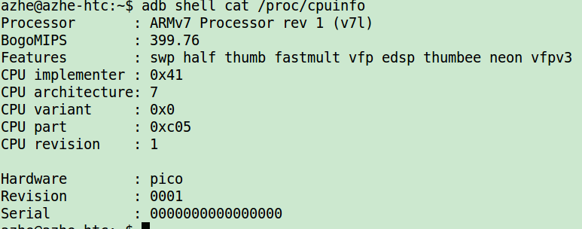
Short Delays
software loop:
1. busy-waiting
udelay (and possibly ndelay too) uses a software loop based on the processor speed calculated at boot time, using the integer variable loops_per_jiffy. The kernel computes loops_per_jiffy on boot via calibrate_delay().
#include <linux/delay.h>
void ndelay(unsigned long nsecs);
void udelay(unsigned long usecs);
void mdelay(unsigned long msecs);
2. Sleep
void msleep(unsigned int millisecs);
unsigned long msleep_interruptible(unsigned int millisecs);
void ssleep(unsigned int seconds)

Slide 26
High-Resolution Timers
struct hrtimer
<hrtimer.h>
struct hrtimer {
  ....
  ktime_t expires;
  int (*function)(struct hrtimer *);
  ...
};
1)
void hrtimer_init(struct hrtimer *timer, clockid_t which_clock, enum hrtimer_mode mode);
which_clock:CLOCK_MONOTONIC: starts at 0 when the system is booted ;CLOCK_REALTIME:the real time of the system
mode:
enum hrtimer_mode {
  HRTIMER_MODE_ABS, /* Time value is absolute */
  HRTIMER_MODE_REL, /* Time value is relative to now */
};
2)
int hrtimer_start(struct hrtimer *timer, ktime_t tim, const enum hrtimer_mode mode);
3)
int hrtimer_cancel(struct hrtimer *timer)
int hrtimer_try_to_cancel(struct hrtimer *timer)
int hrtimer_restart(struct hrtimer *timer)

Slide 27
High-Resolution Timers
Useage:
E.g.: vibrator
1)
hrtimer_init(&vib->vib_timer, CLOCK_MONOTONIC, HRTIMER_MODE_REL);
vib->vib_timer.function = pmic8058_vib_timer_func;
2)
static enum hrtimer_restart pmic8058_vib_timer_func(struct hrtimer *timer)
{
struct pmic8058_vib *vib = container_of(timer, struct pmic8058_vib,
vib_timer);
vib->state = 0;
schedule_work(&vib->work);
return HRTIMER_NORESTART;
}
3)
static enum hrtimer_restart pmic8058_vib_timer_func(struct hrtimer *timer)
{
struct pmic8058_vib *vib = container_of(timer, struct pmic8058_vib,
vib_timer);
disable_vibrator();
return HRTIMER_NORESTART;
}

Slide 28
Q&A
1. Busy waiting disable preempt?
?

Slide 29
Thank you!

